Slide 1
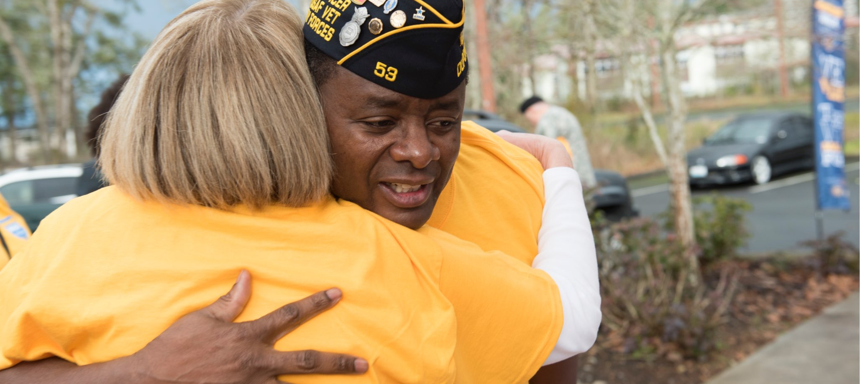
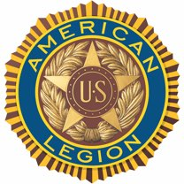
THIS IS
Notes:
U.S. wartime veterans serving their fellow veterans, supporting our nation’s troops, mentoring young people, volunteering in communities and promoting patriotism throughout the United States and beyond: This is The American Legion.

Slide 2
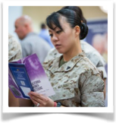

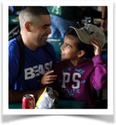
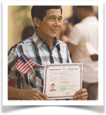
ABOUT THE LEGION
OUR PILLARS OF SERVICE
VETERANS
YOUTH
VA benefit and appeal assistance
Job and career guidance
Homeless outreach
Scholarships
Youth programs and competitions
Junior ROTC and Scouting sponsorship
DEFENSE
AMERICANISM
Military family support
Comfort items for wounded servicemembers
Advocacy for troops and military in Washington, D.C.
Flag respect education
Citizenship services
Support for the Pledge of Allegiance and National Anthem
Notes:
With more than 2.1 million members, The American Legion is the nation’s largest veterans service organization. Since its founding shortly after the end of World War I, The American Legion has dedicated itself to four main pillars of service: Veterans, Defense, Youth and Americanism.
In service to VETERANS, The American Legion provides free benefits counseling, advocacy for superior health care, support for veterans making the transition to civilian careers and help for the homeless.
In service to THOSE WHO DEFEND OUR NATION, The American Legion promotes a decent quality of life, an adequately funded Department of Defense, fair military retirement benefits, free discharge review services and, at the local level, home-front support for the men and women in harm’s way.
In support of our nation’s YOUTH, The American Legion provides and operates life-changing programs including Boys State and Boys Nation, American Legion Baseball, Junior Shooting Sports, oratorical competitions, Scouting units and much more.
As leading ambassadors of AMERICANISM, The American Legion provides U.S. Flag education, leads patriotic ceremonies and services, promotes legal citizenship and naturalization and more.

Slide 3
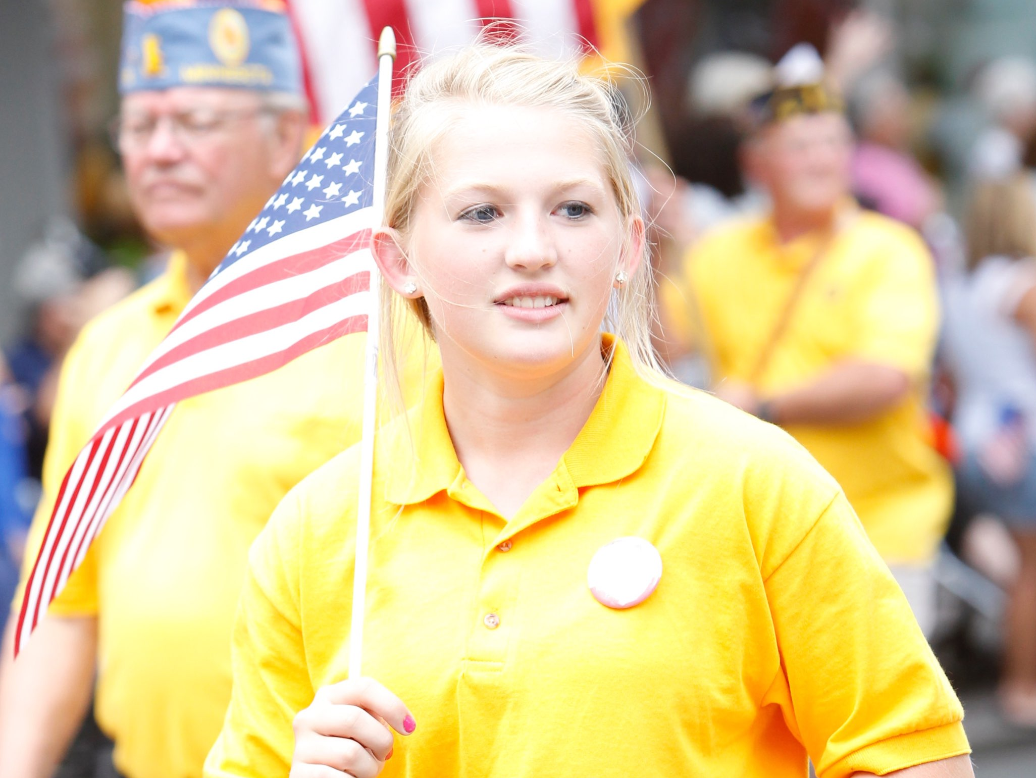
ABOUT THE LEGION
THE AMERICAN LEGION FAMILY
More than 2.1 million members of The American Legion
Nearly 1 million members of The American Legion Auxiliary
More than 360,000 members of The Sons of The American Legion
Notes:
In addition to the 2.1 million wartime veterans who are members of The American, the American Legion Family also consists of The American Legion Auxiliary with nearly 1 million members and Sons of The American Legion, male descendants of U.S. wartime veterans, who number more than 360,000.

Slide 4
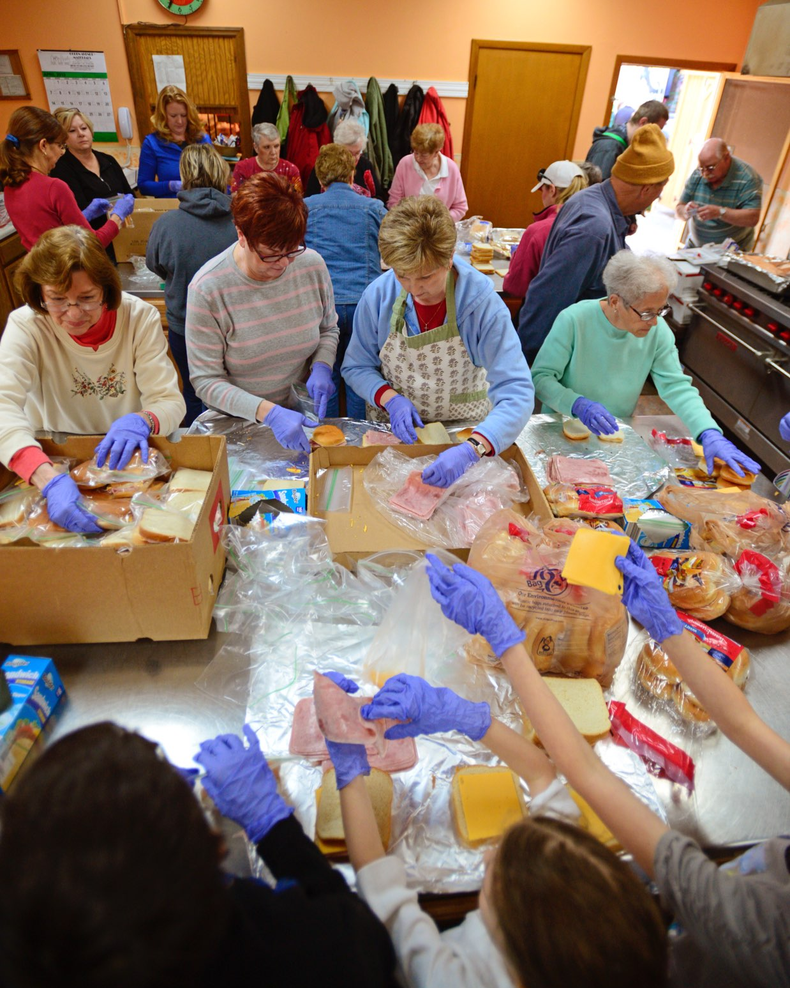
ABOUT THE LEGION
COMMUNITY FOOTPRINT
13,500 American Legion Posts
North America
The Caribbean
Europe
Latin America
Asia
Notes:
The American Legion works through nearly 13,500 local posts around the world. Each U.S. state has an American Legion department and local posts within it. In addition to the U.S. state departments, American Legion departments operate in the District of Columbia, France, Mexico, Puerto Rico and the Philippines. Whether it’s a rural county, an urban neighborhood, a college campus, a military community, a state capital or Capitol Hill, The American Legion has multiple community footprints, large and small.

Slide 5
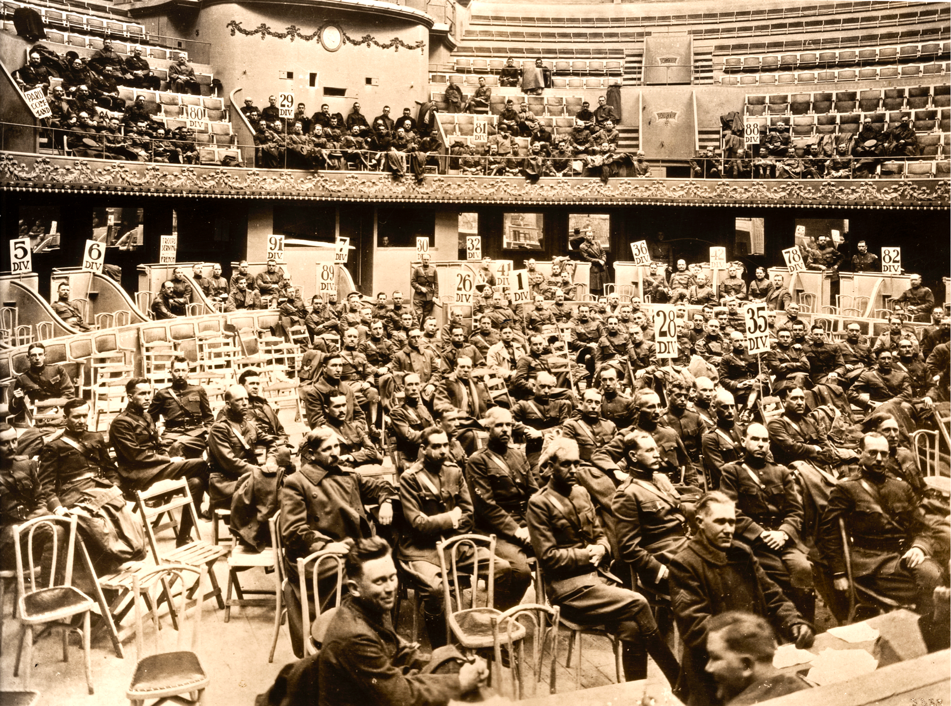
HISTORIC MOMENTS
1919
Since its founding nearly a century ago, The American Legion has influenced multiple important changes in America.
Notes:
The American Legion was founded in March 1919 in Paris, France, by a group of U.S. World War I veterans still occupying Europe. They were deeply concerned about the welfare of their fellow veterans returning home, and their families. Often, World War I veterans resumed civilian lives dramatically changed: severely wounded, gassed or suffering from what was then known as “shell shock.” The American Legion’s founders established enduring priorities to help those veterans and their families and, along the way, strengthen communities everywhere.

Slide 6
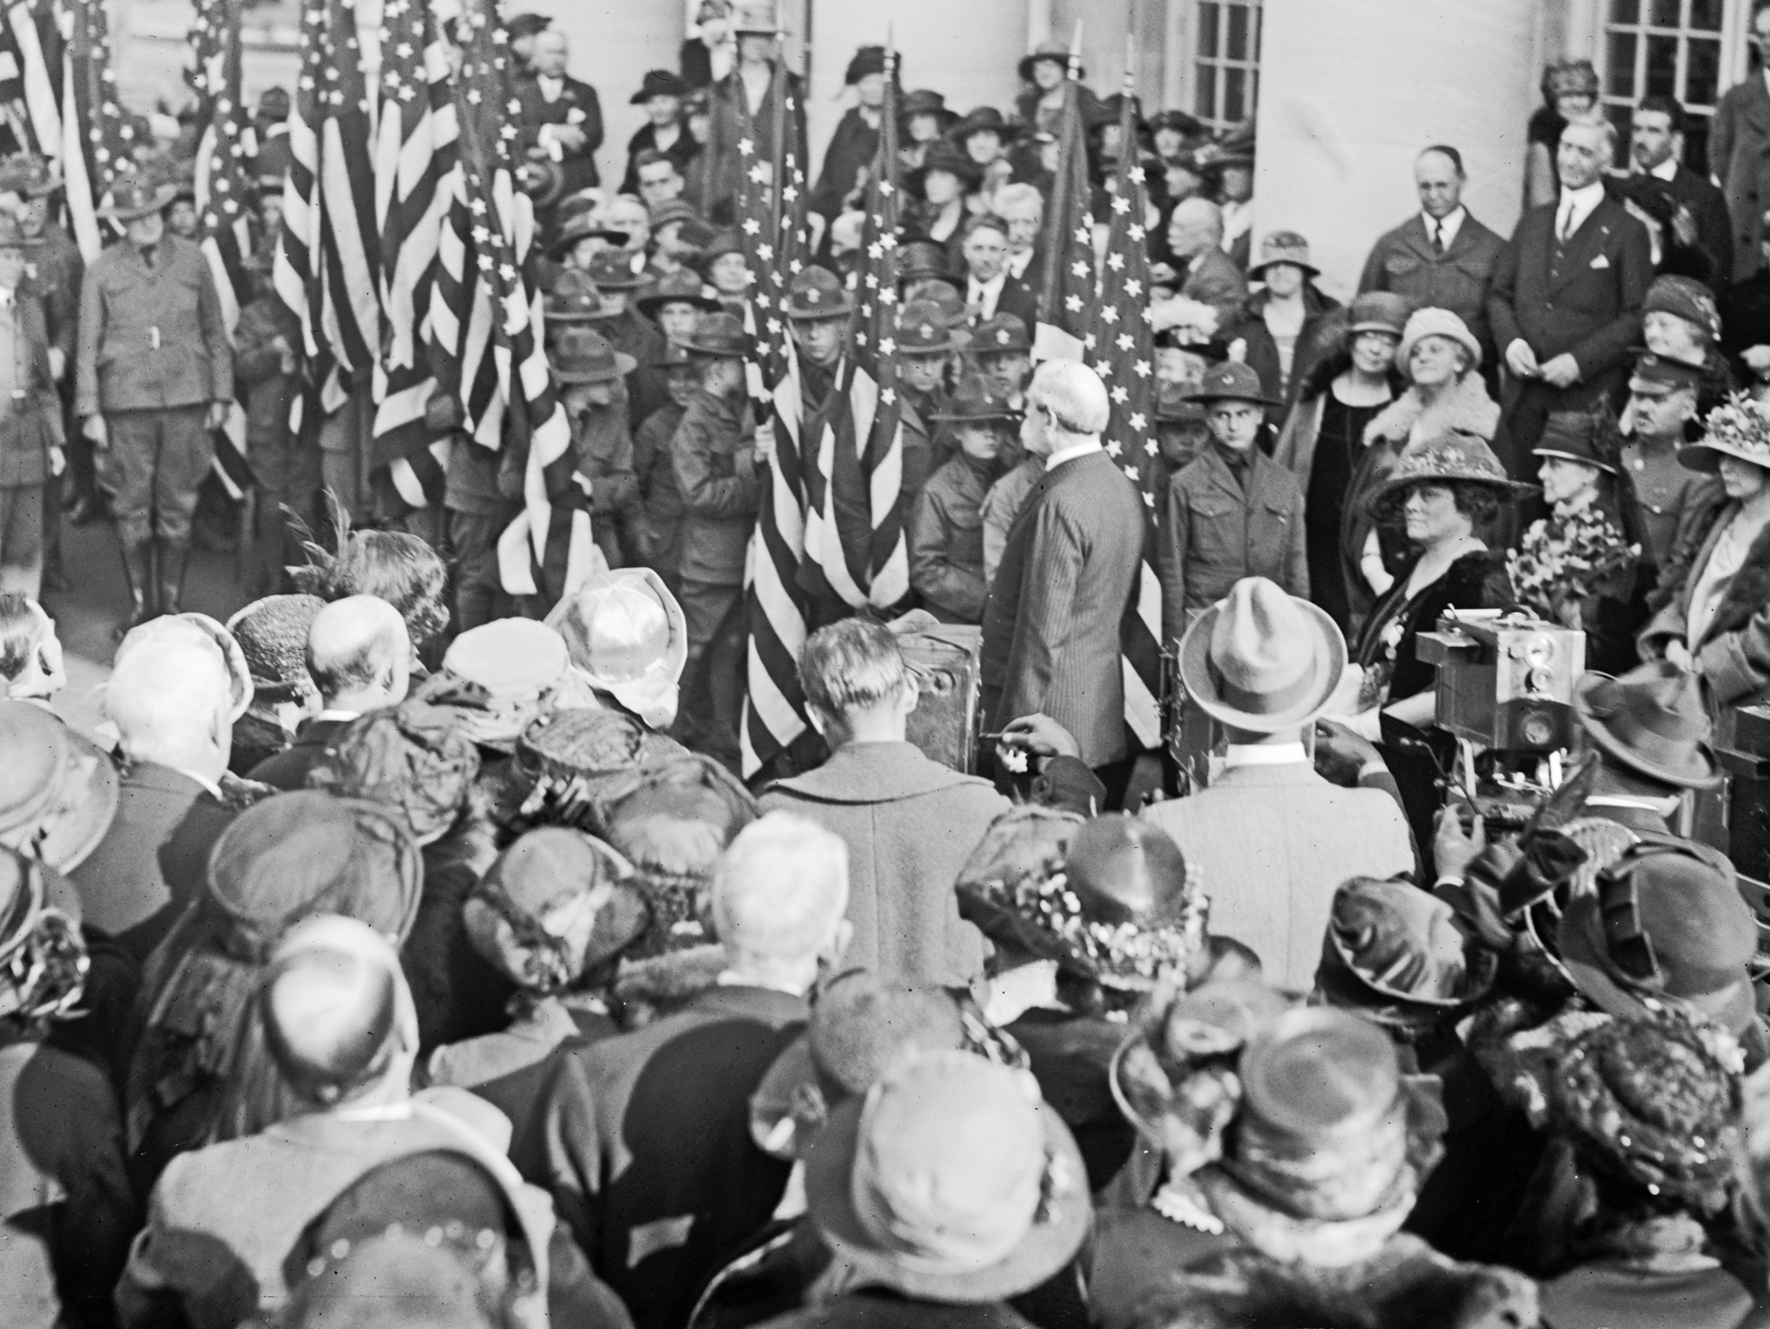
OUR HISTORY
U.S. FLAG CODE
American Legion conferences establish standardized rules of respect and display for Old Glory.
Notes:
Throughout its first century, The American Legion led many significant movements that changed the course of the nation and improved the lives of millions. It was The American Legion that arranged a national flag conference in 1923 that led to the acceptance of U.S. Flag Code and, eventually, adoption by Congress. Prior to that, there were no standard rules for treatment and respect for our nation’s colors.

Slide 7
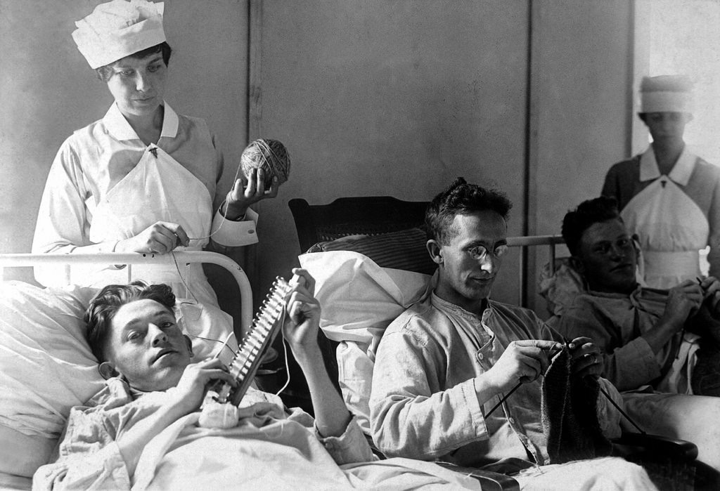
OUR HISTORY
FORMATION OF THE VA
Worked to consolidate multiple disconnected federal offices, agencies and bureaus into one Veterans Administration.
Notes:
In its first decade, The American Legion worked tirelessly to ensure that wounded, sick and suffering war veterans had adequate health care. That work included convincing the federal government to consolidate many bureaus, offices and risk management agencies into one entity in 1930: The Veterans Administration.

Slide 8
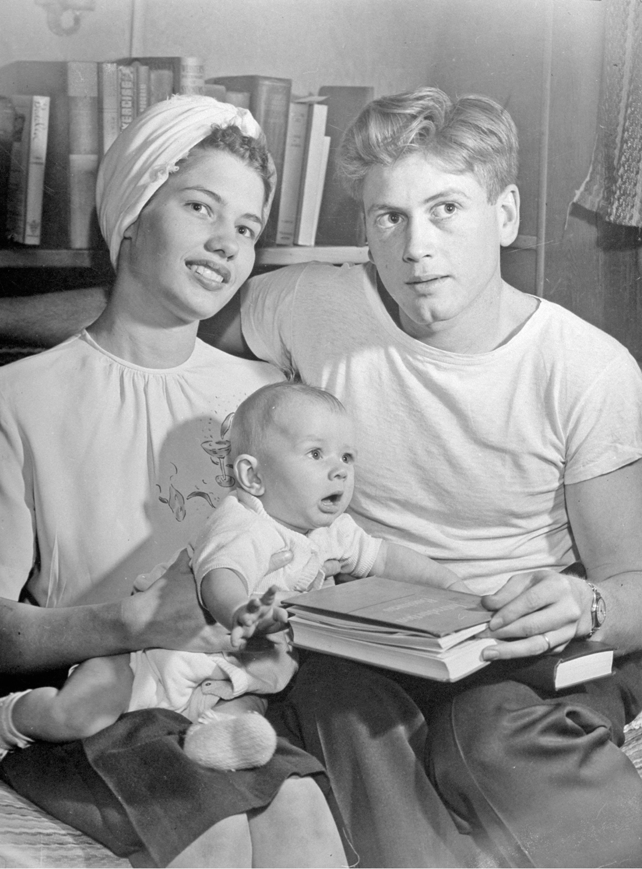
OUR HISTORY
THE GREATEST LEGISLATION
Formulated, drafted and fought for passage of the the Servicemen’s Readjustment Act of 1944.
The GI Bill
  Educated millions
  Triggered a half-century of economic prosperity
  Revolutionized higher education
  Made home ownership possible for average Americans
  Created the American middle-class
  Allowed for an
  all-volunteer military
Notes:
The American Legion’s founding generation made its most significant contribution to the nation in 1943 and 1944. The Servicemen’s Readjustment Act of 1944 – which has been described as the most significant social legislation of the 20th century – was developed, drafted and brought to passage by The American Legion. College benefits, business assistance, low-interest home loans and improved VA health-care services were among the many ways the GI Bill changed America.
Instead of economic disaster when the troops came home from World War II, the nation enjoyed a half-century of prosperity. Critics said the GI Bill would break the treasury. Instead, it has been estimated that for every dollar invested in the GI Bill, seven dollars returned to the U.S. economy. The American Legion has fought to ensure that the GI Bill is relevant, updated and just as effective for veterans of the Post 911 era.

Slide 9
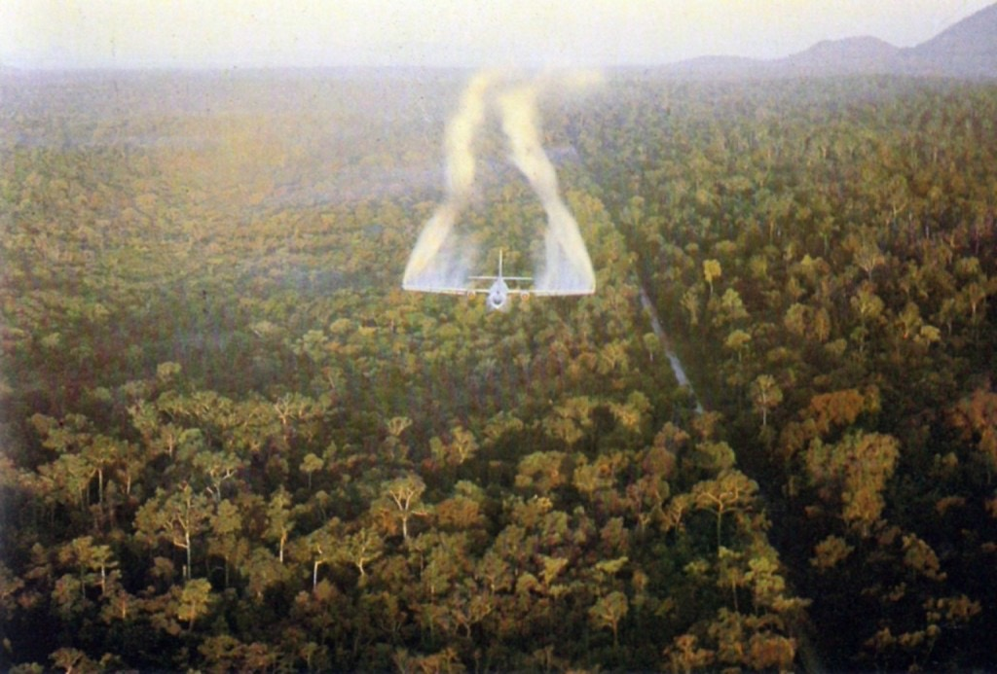
OUR HISTORY
SERVICE-CONNECTED CONDITIONS
The 1983 American Legion-Columbia University Study on the effects of Agent Orange exposure on Vietnam War veterans was one of many ways the organization helped suffering veterans receive care and benefits.
Notes:
Throughout its first century, The American Legion has fought for fairness to veterans who were exposed to toxic chemicals or suffered other service-connected health conditions while in the military. During the 1980s, The American Legion and Columbia University led a national study that defied federal government findings and revealed that wartime exposure to the defoliant Agent Orange had caused many illnesses and deaths. Today, because of that work, exposure to Agent Orange is blamed for many service-connected illnesses.

Slide 10
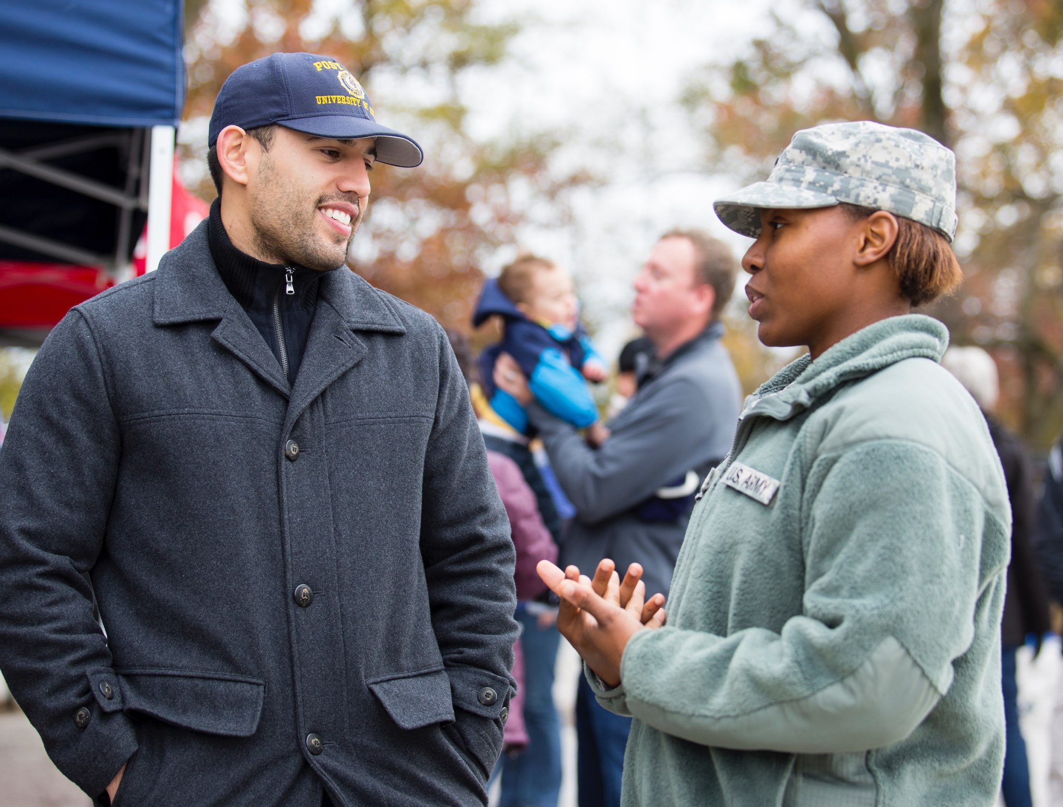
TODAY’S
AMERICAN LEGION
Notes:
Today, new generations of American Legion members meet the changing needs of veterans, the military, families and communities. American Legion posts, for instance, are sprouting up on college campuses to help veteran students understand their 21st century education benefits. Post 911 generation veterans are assuming leadership roles in The American Legion, offering vibrant new programs and services while still connected to the deeper values and legacy of the organization.

Slide 11
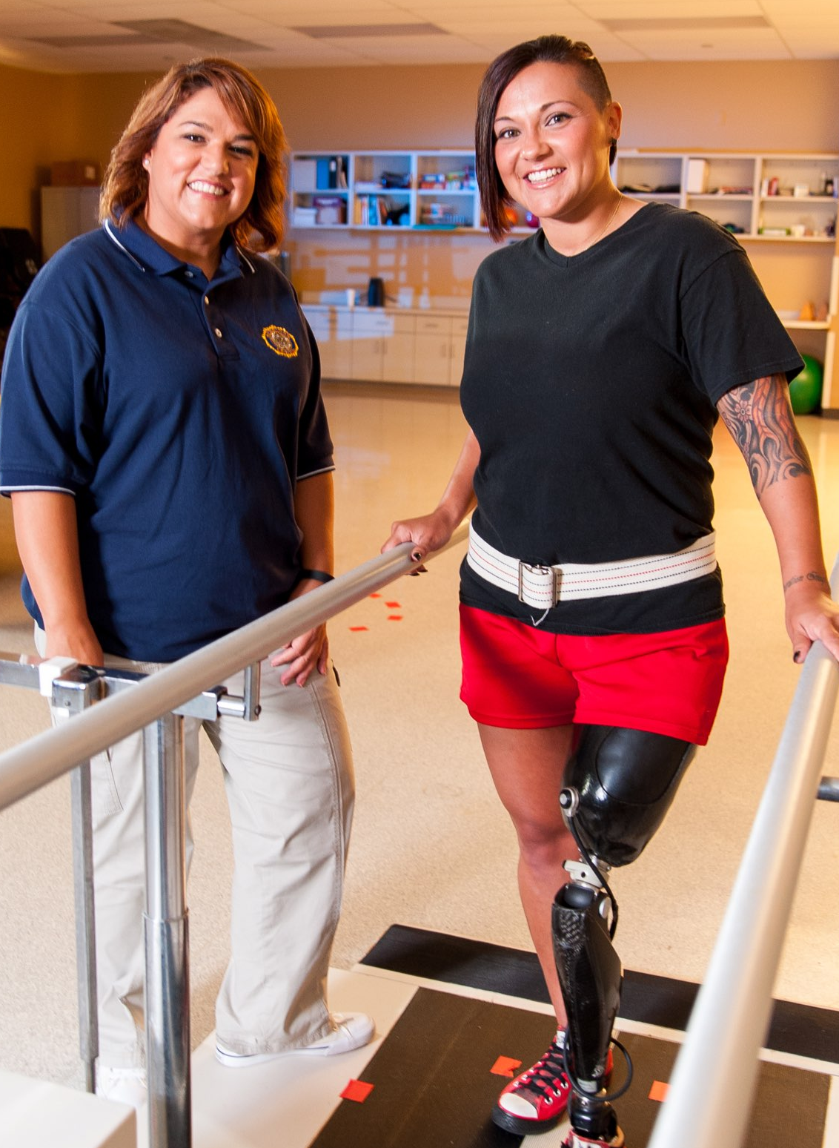
SERVICES FOR VETERANS
VETERANS AFFAIRS & REHABILITATION
Free representation for some 750,000 veterans and families seeking VA disability and medical benefits at any one time
Support for veterans suffering from PTSD and TBI
Millions of volunteer hours and services at VA facilities
Representation before Congress and the White House to provide timely VA health care and efficient benefits processing
Notes:
The Veterans Affairs & Rehabilitation arm of The American Legion performs a diverse array of services to help veterans and their families navigate VA and state veterans benefits systems. More than 2,500 accredited American Legion service officers are assisting no fewer than 750,000 veterans at any one time. These compassionate professionals help with disability benefits applications, health care, education opportunities, jobs and much more.

Slide 12
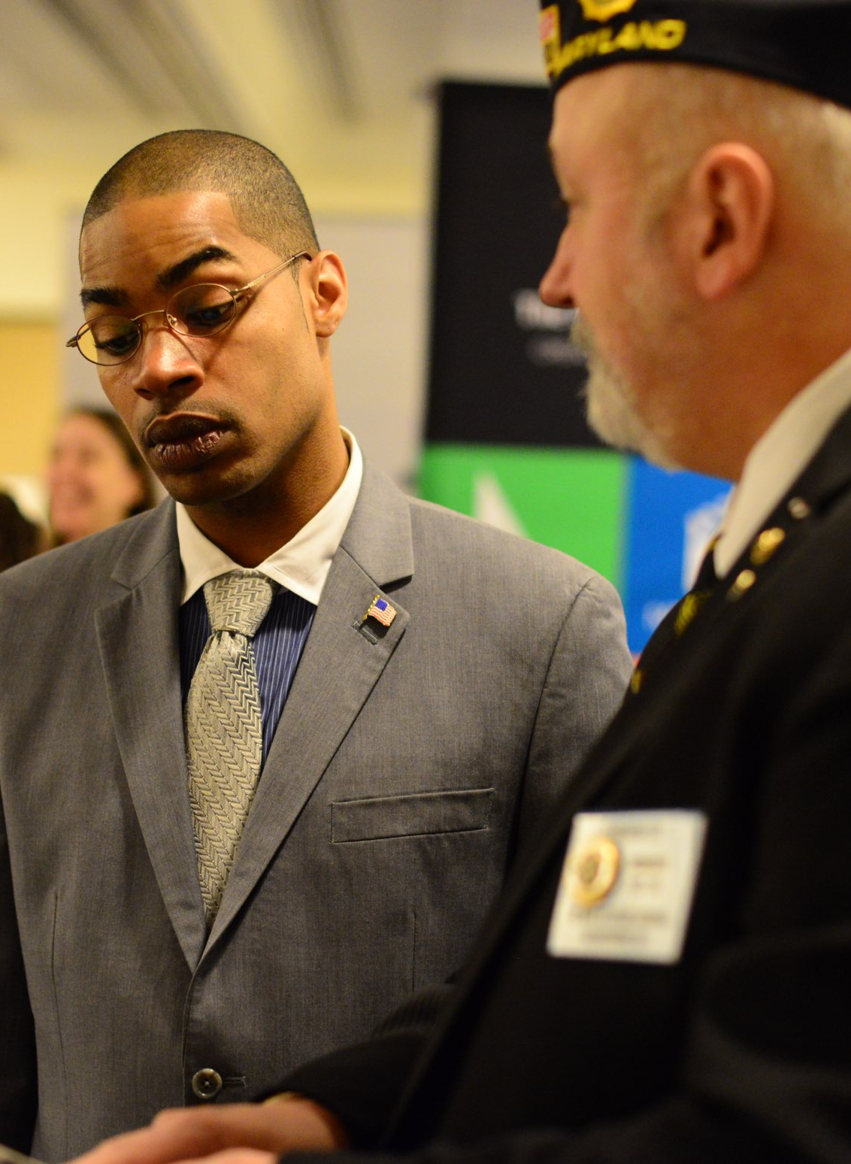
SERVICES FOR VETERANS
VETERANS EDUCATION & EMPLOYMENT
More than 1,000 job fairs and other career events for veterans and their families every year, nationwide
Fighting for fair conversion of military experience to credit hours for civilian careers in specialized fields
Mentorship and advice for veteran entrepreneurs
Relief, support and help for homeless veterans
Notes:
The American Legion Veterans Education and Employment Division coordinates and supports hundreds of job fairs and career events, provides business consultation, help for student veterans and relief for those who have fallen into homelessness.

Slide 13
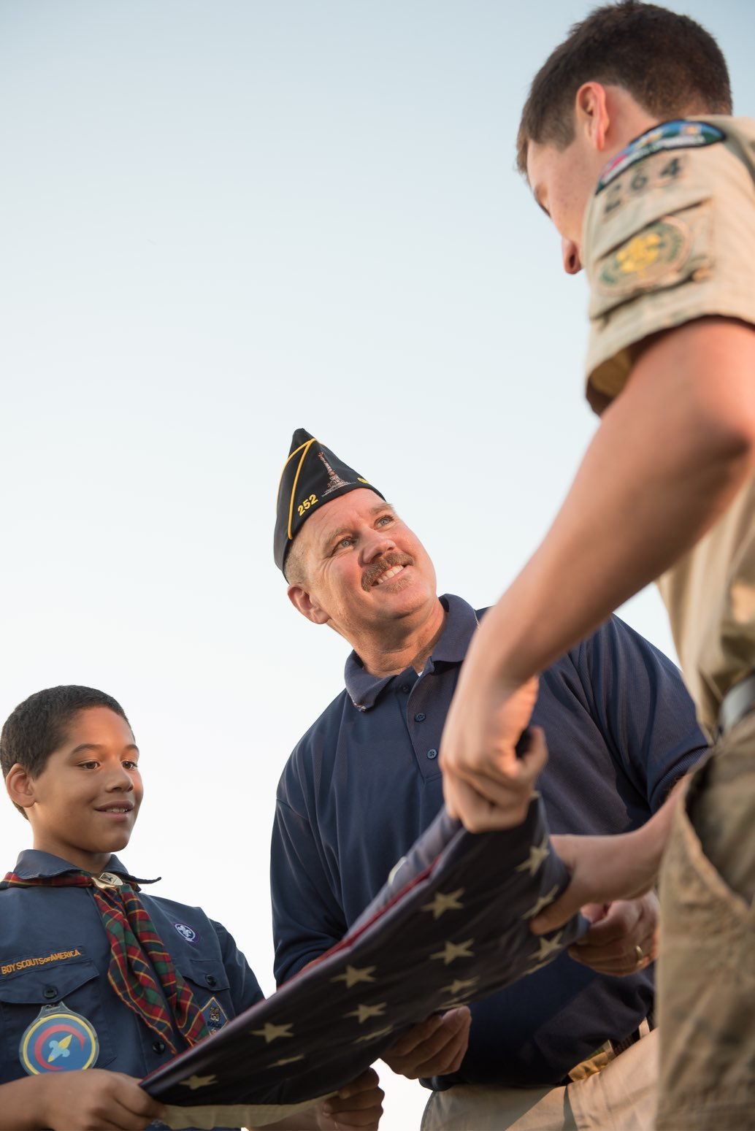
SERVICES FOR YOUTH
CHILDREN & YOUTH PROGRAMS
Financial assistance for needy military and veteran families with young children
Grants to organizations that provide support for children in need
College scholarships to children of
U.S. servicemembers killed while on active duty since Sept. 11, 2001
Mentorship through American Legion Boys State, Boys Nation and Oratorical Competition
Youth programs, including more than 3,000 Scout units, nearly 4,000 American Legion Baseball teams, dozens of Junior Shooting Sports Clubs, Junior ROTC and Youth Cadet Law Enforcement Programs
Notes:
Boys State and Boys Nation teach young men not only how a democratic form of government works, but also why it’s important. American Legion Oratorical Contests not only help young people with their public-speaking skills, they also teach them to research, understand and appreciate the U.S. Constitution. American Legion Baseball, Junior Shooting Sports, Law Cadet programs and hundreds of scholarship opportunities are among the many ways the Legion improves lives of young people.

Slide 14
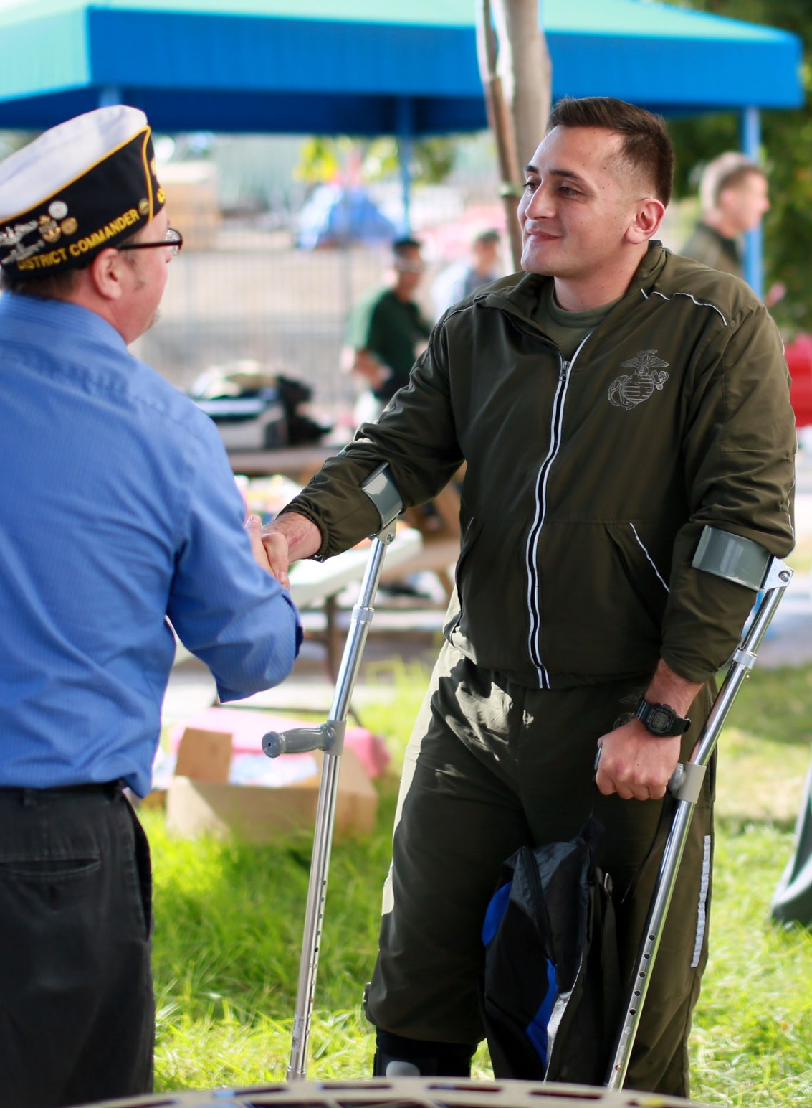
MILITARY SUPPORT
NATIONAL SECURITY
Advocacy in Washington, D.C., for quality-of-life benefits for members of the Armed Forces
Comfort items for hospitalized military personnel recovering from wounds and illnesses
Fair treatment and support for military retirees
Discharge review services
Support for adequate defense funding
Adoption of deployed units and volunteerism at National Guard armories
Notes:
The American Legion’s National Security mission centers on quality of life for members of the U.S. Armed Forces, National Guard and Reserves. The mission also includes fighting in Washington for Defense funding that will protect American forces in harm’s way. Support for fair military retirement benefits and TRICARE also fit under the Legion’s National Security umbrella.

Slide 15
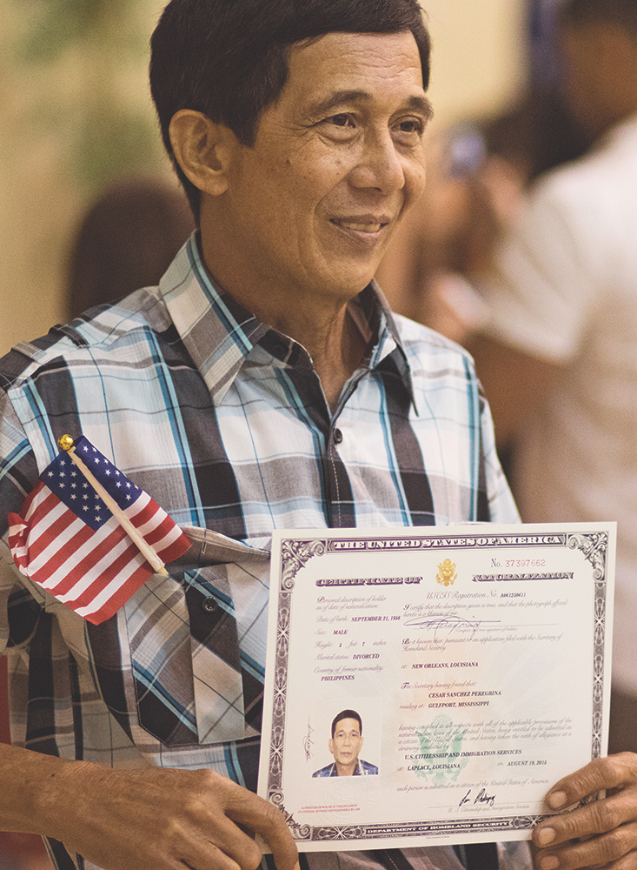
AMERICANISM
PATRIOTIC VALUES
The nation’s foremost authority on U.S flag respect, procedures and code
Support for public expression of the Pledge of Allegiance and the national anthem
Classroom presentations for children on such topics as flag respect, military service, history and patriotism
Citizenship and naturalization education and support for legal immigrants seeking to become Americans
Notes:
As ambassadors of American patriotism, no one compares to The American Legion. Respect for the U.S. Flag and the rules that govern its proper display are top priorities to those who served the nation under the Colors. The Legion also stands strong for naturalization and legal citizenship, respect for patriotic holidays and ceremonies, protection of military and veteran monuments and more.

Slide 16
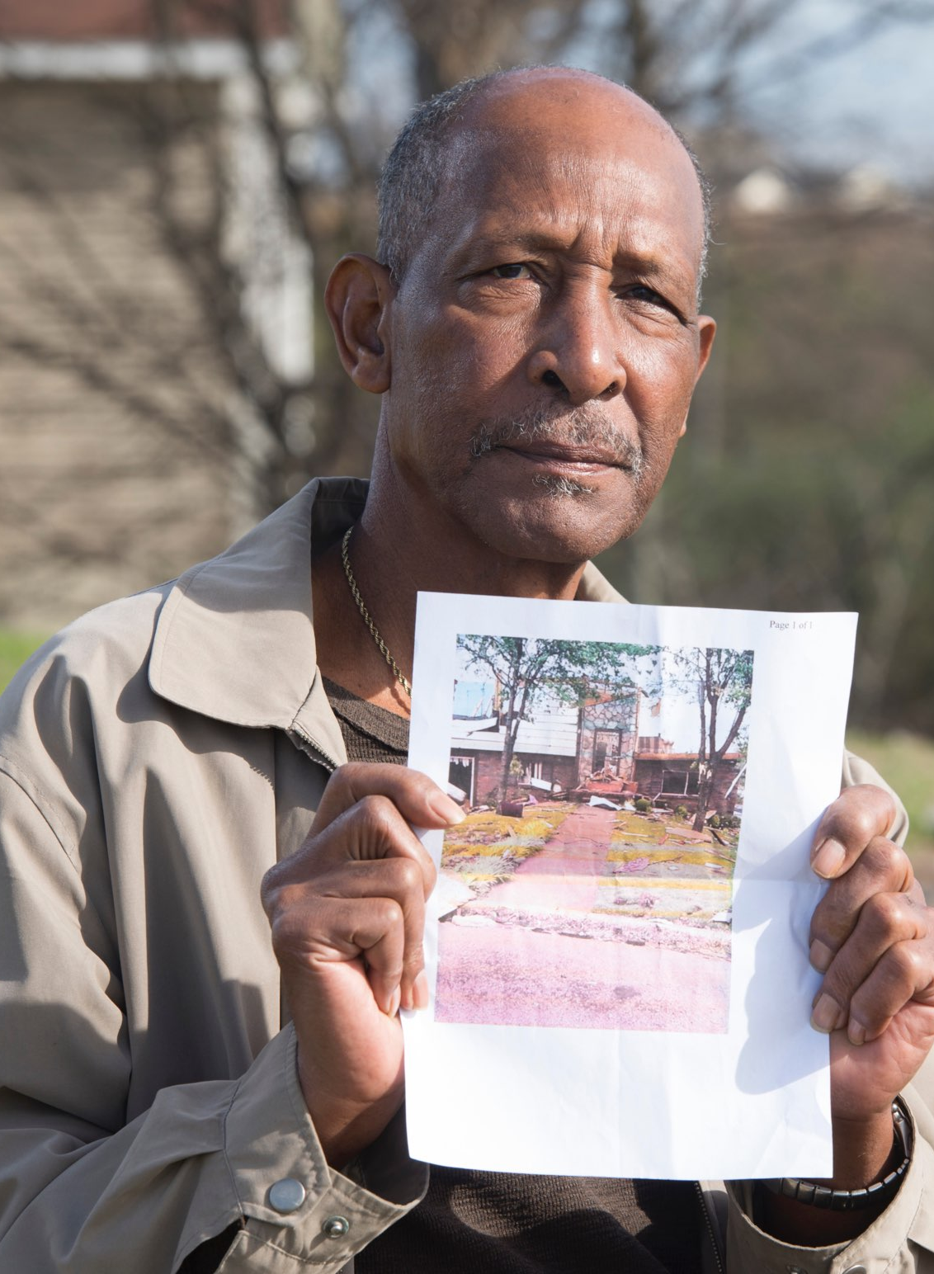
IN TIMES OF NEED
CRISIS CONTROL
The National Emergency Fund has provided more than
$8 million in direct financial assistance to American Legion members and posts after crises
Posts serve as relief stations and command centers during natural disasters
The Family Support Network ensures families of deployed service members endure no hardship caused by their service
Temporary Financial Assistance program awards grants to help families of veterans with children
Notes:
In times of catastrophe, The American Legion Family goes to work. The National Emergency Fund provides cash grants for veterans whose lives are turned upside-down by floods, fires, tornadoes and other natural disasters. The Legion also provides firsthand support and relief for displaced families. In many communities, American Legion posts are vital to local civil defense programs.
The Legion also provides Temporary Financial Assistance relief to military families with children at home when they fall on difficult times. The Legion’s Family Support Network is also available for military and veteran families that can use volunteer help.

Slide 17
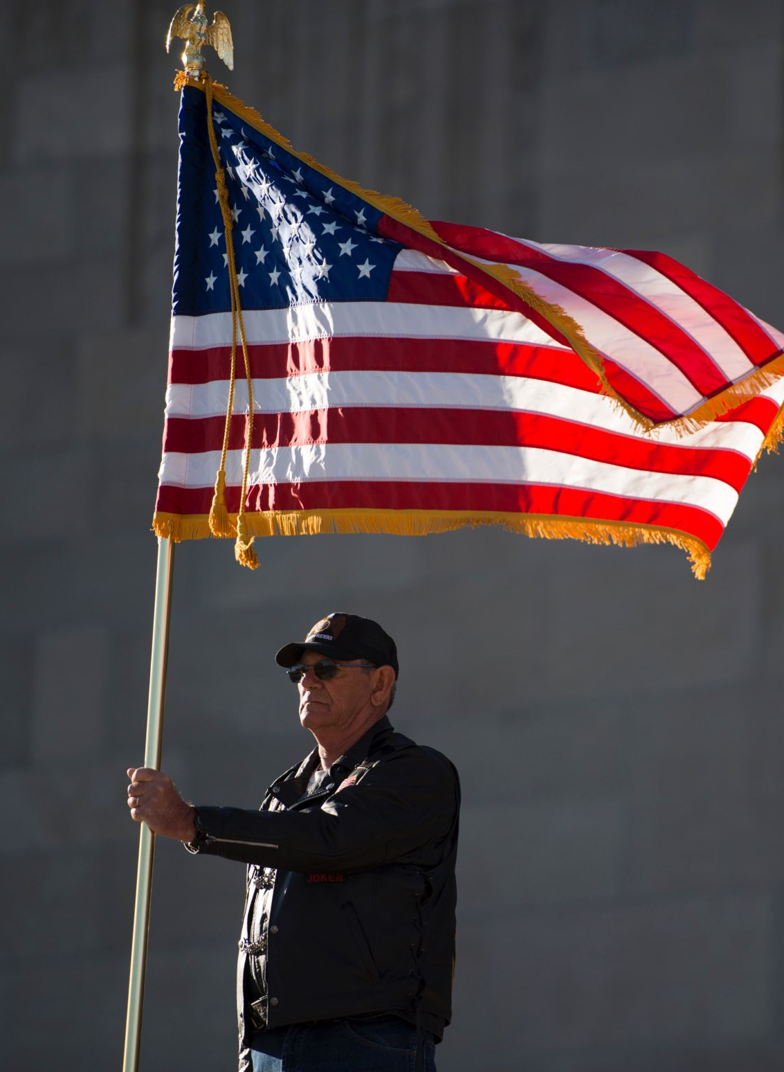
HONOR & REMEMBRANCE
PRESERVATION OF MEMORIES
Provision and delivery of U.S. flags for the graves of American military personnel laid to rest at overseas cemeteries
Demand full accounting and repatriation of all U.S. military personnel listed as prisoners of war or missing in action
Participation in thousands of patriotic observances and events around the world each year
Honor guard services and memorial tributes for fallen military personnel and veterans
Notes:
Memorials, cemeteries, monuments and special events to honor past battles and the men and women who served in them are sacred to The American Legion. Thousands of American Legion honor guards officiate at veteran funeral services each year. All flags that fly over U.S. military graves in foreign countries are provided free of charge by The American Legion.

Slide 18
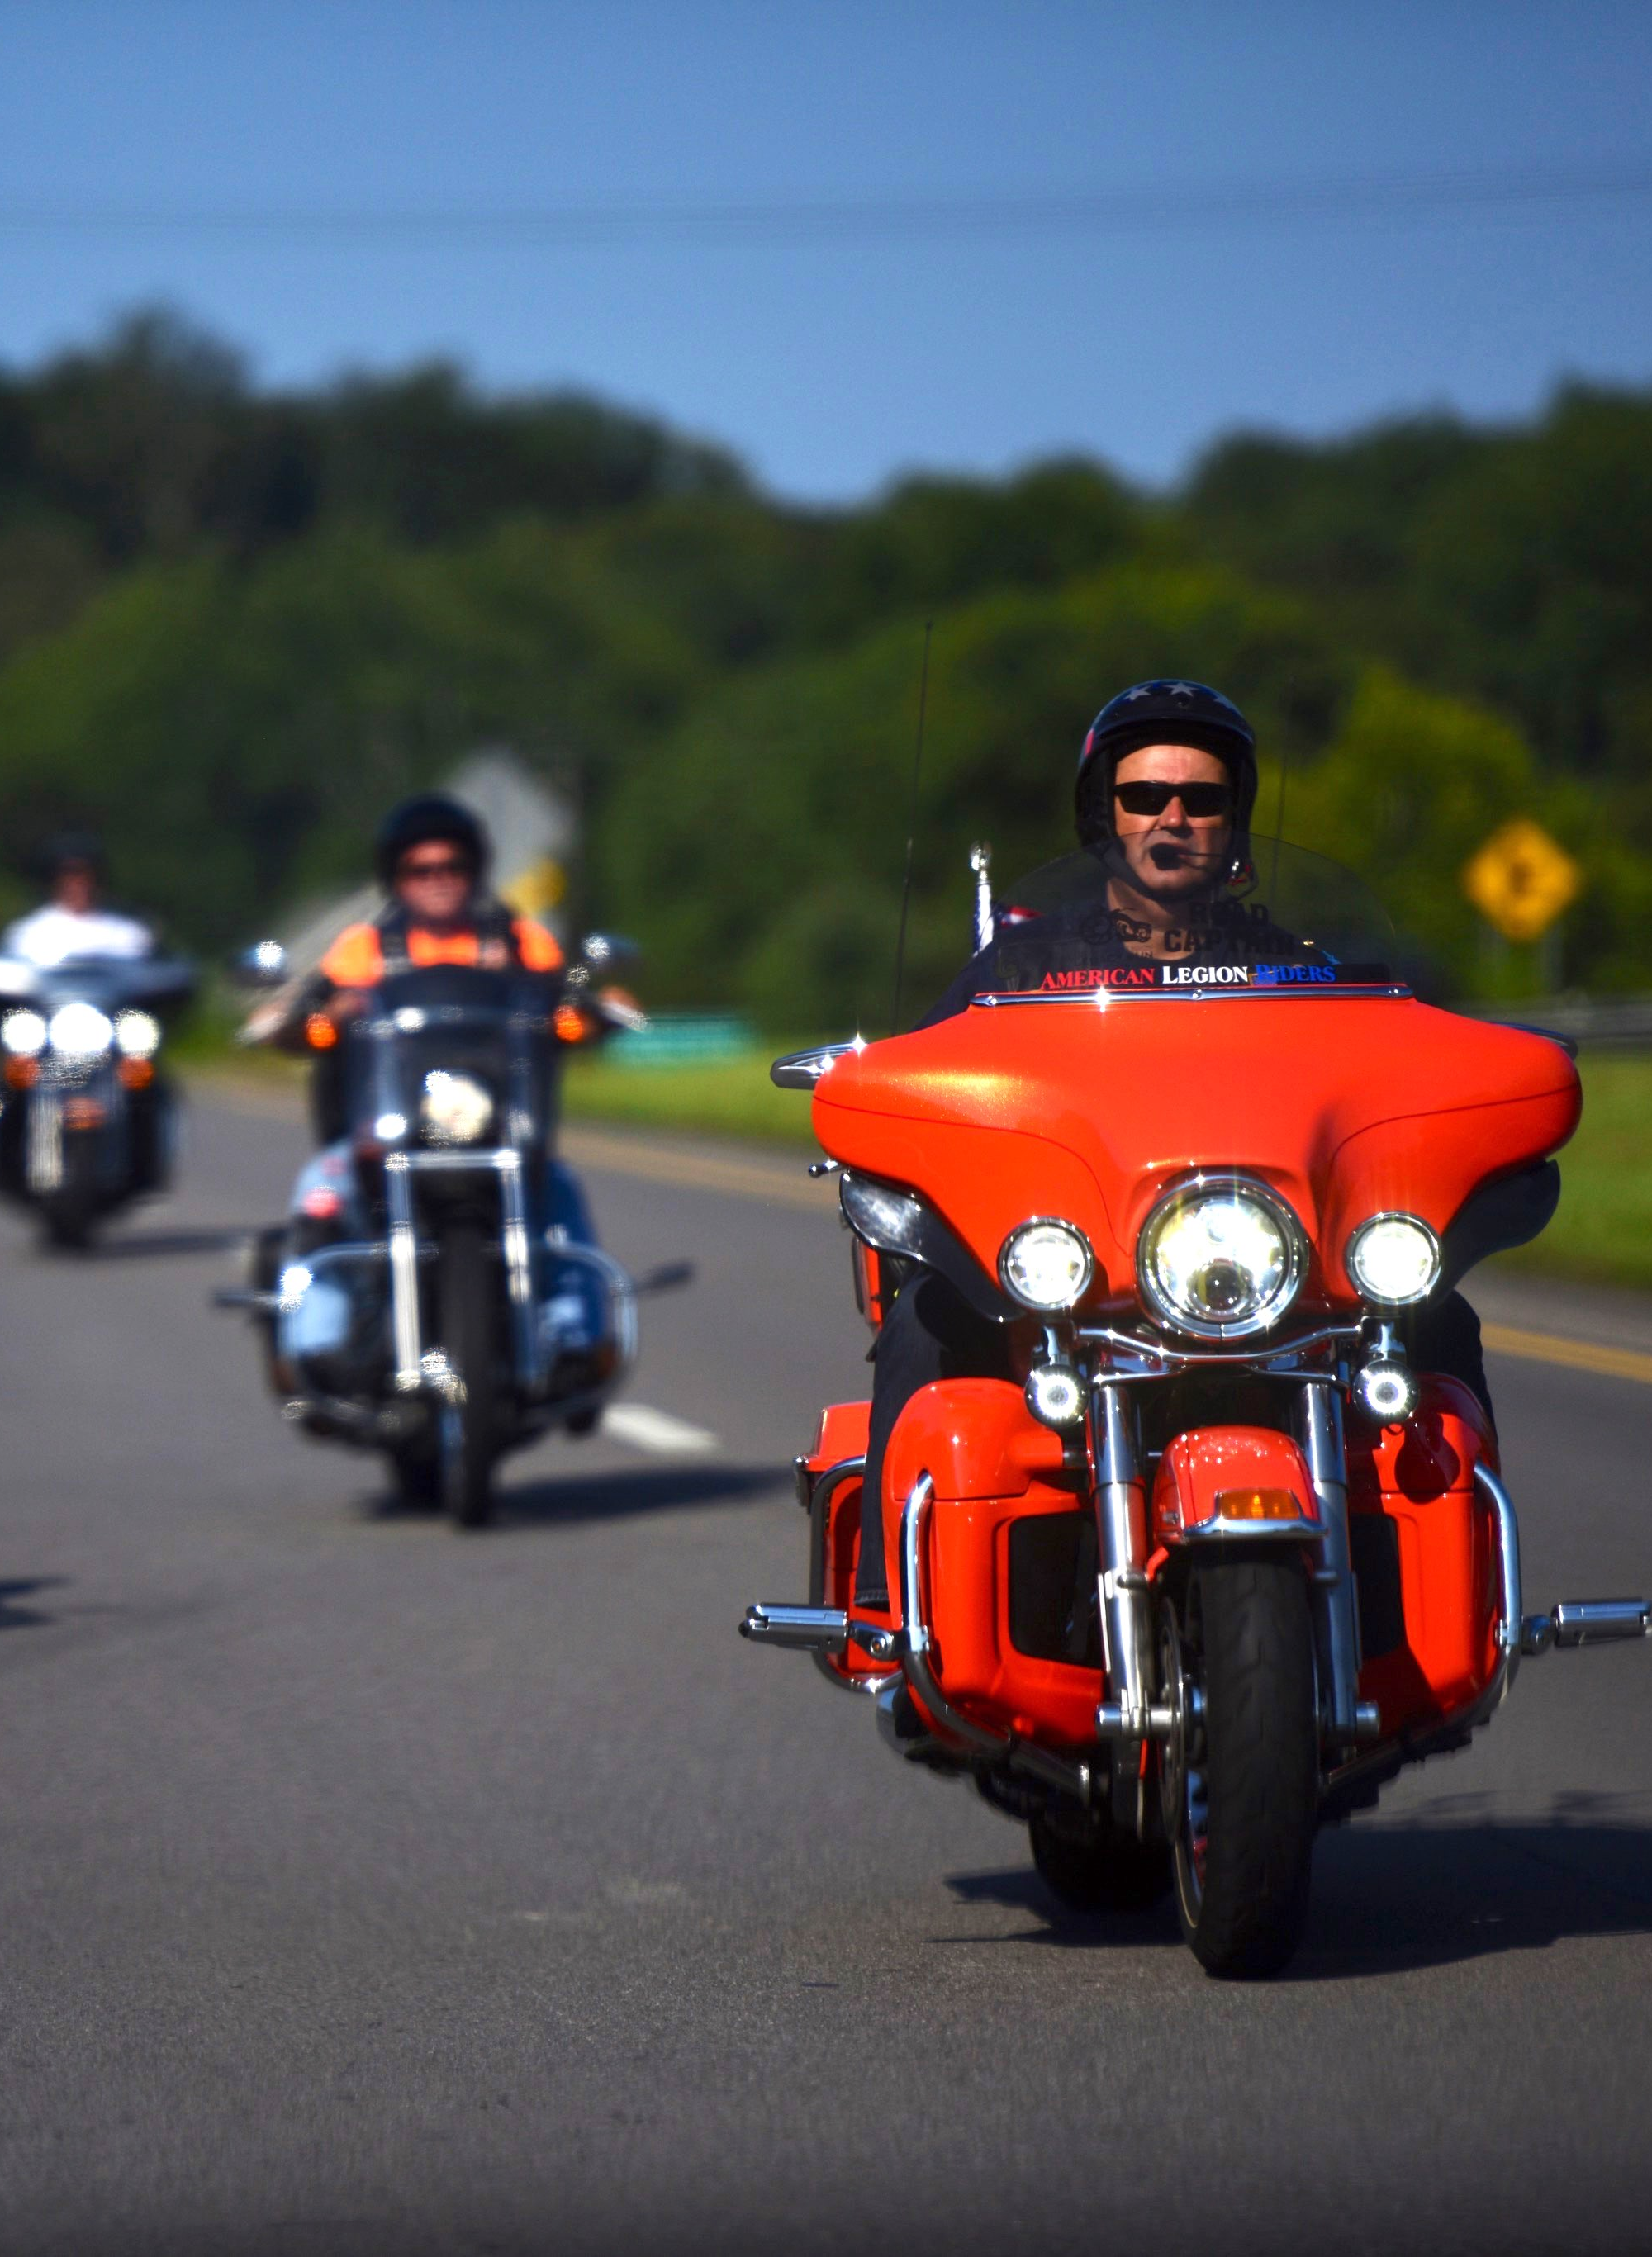
COMMUNITY
THE LEGION
IS LOCAL
Every American Legion post is its own entity, working alongside local government, business and civic groups
Legionnaires help schools with flag education, military history, Boys State, Oratorical contests, Junior ROTC, Junior Shooting Sports, American Legion Baseball and more
Legion Riders hit the road to raise funds, provide military funeral escorts and to volunteer for multiple local, state and national causes
Notes:
Every major American Legion initiative – from Boys State to Legion Riders to Junior Shooting Sports – was at first a local idea. American Legion posts work closely with schools, businesses, civic organizations and local governments to ensure that the values of those who served in uniform are shared and understood by their friends and neighbors.

Slide 19
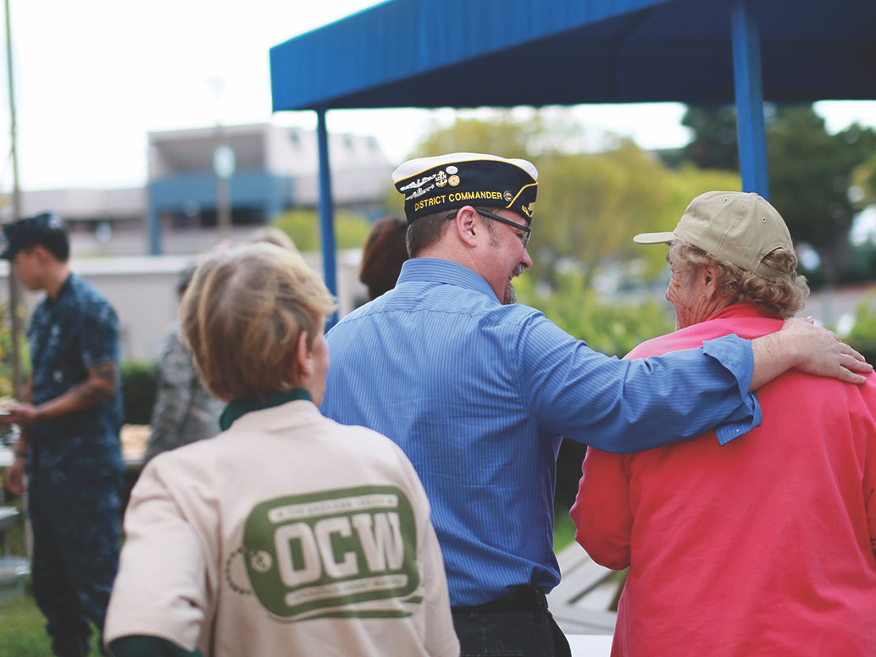
HOW YOU CAN HELP
HELP US
HELP OTHERS
JOIN
www.legion.org/join
800 433-3318
GET INVOLVED
www.alaforveterans.org
www.legion.org/sal
www.legion.org/riders
GIVE
www.legion.org/donate
(800) 433-3318
Notes:
Legacy and vision. That is the motto of The American Legion’s coming 100th anniversary celebration. The military men and women who formed The American Legion in 1919 resolved to serve one another and their communities, states and nation without regard for personal gain. Such was the vision of what would become the nation’s largest veterans organization, one that has outlasted thousands of other associations and businesses, and continues to make differences everywhere.
You can learn more about The American Legion at www.legion.org, or on Facebook and Twitter.

Slide 20
THIS IS
the American Legion
LOCAL CONTACT
NAME HERE
name@email.com
www.website.com
(000) 000-0000
Notes:
USE THIS SLIDE FOR ANY LOCALIZATION NEEDED – POST, DISTRICT, DEPARTMENT OR DIVISIONAL CONTACTS AS APPROPRIATE. If not needed – delete text box and leave the space blank

