Slide 1
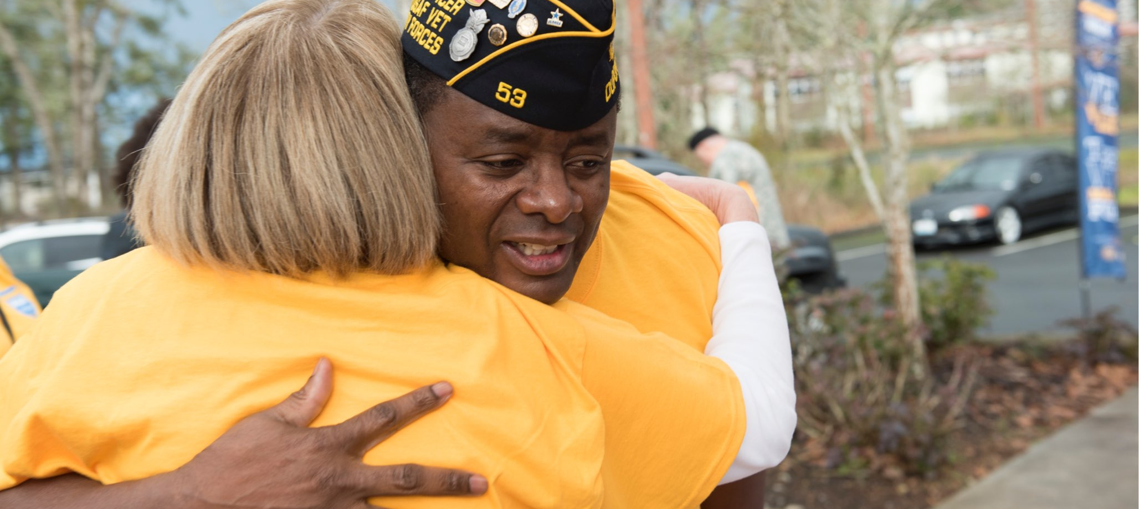
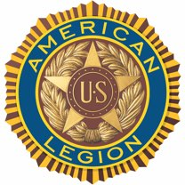
THIS IS
Notes:
U.S. wartime veterans serving their fellow veterans, supporting our nation’s troops, mentoring young people, volunteering in communities and promoting patriotism throughout the United States and beyond: This is The American Legion.

Slide 2
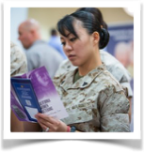

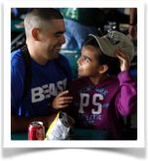
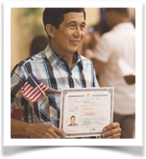
ABOUT THE LEGION
OUR PILLARS OF SERVICE
VETERANS
YOUTH
VA benefit and appeal assistance
Job and career guidance
Homeless outreach
Scholarships
Youth programs and competitions
Junior ROTC and Scouting sponsorship
DEFENSE
AMERICANISM
Military family support
Comfort items for wounded servicemembers
Advocacy for troops and military in Washington, D.C.
Flag respect education
Citizenship services
Support for the Pledge of Allegiance and National Anthem
Notes:
With more than 2.1 million members, The American Legion is the nation’s largest veterans service organization. Since its founding shortly after the end of World War I, The American Legion has dedicated itself to four main pillars of service: Veterans, Defense, Youth and Americanism.
In service to VETERANS, The American Legion provides free benefits counseling, advocacy for superior health care, support for veterans making the transition to civilian careers and help for the homeless.
In service to THOSE WHO DEFEND OUR NATION, The American Legion promotes a decent quality of life, an adequately funded Department of Defense, fair military retirement benefits, free discharge review services and, at the local level, home-front support for the men and women in harm’s way.
In support of our nation’s YOUTH, The American Legion provides and operates life-changing programs including Boys State and Boys Nation, American Legion Baseball, Junior Shooting Sports, oratorical competitions, Scouting units and much more.
As leading ambassadors of AMERICANISM, The American Legion provides U.S. Flag education, leads patriotic ceremonies and services, promotes legal citizenship and naturalization and more.

